Slide 1

PROFESSION ON THE RISE
Facility Asset Management

Slide 2
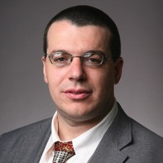
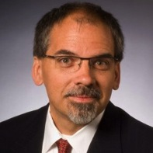
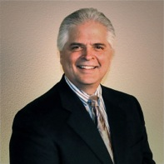
Facility Asset Management
Dr. Sarel Lavy
Associate Professor & Graduate Program Coordinator
Department of Construction Science
College of Architecture
Texas A&M University
Jeffrey J. Tafel, CAE
Executive Director
IFMA Foundation
John A. Garcia
Managing Director of ALPHA Facilities Solutions
President, Texas A&M University Facility Management Industry Advisory Council

Slide 3
AGENDA
The Profession of Facility Asset Management
  History
  Academia
  Skills and Knowledge
  The Job
  The Career

Slide 4
HISTORY
The Profession of Facility Asset Management
John A. Garcia

Slide 5
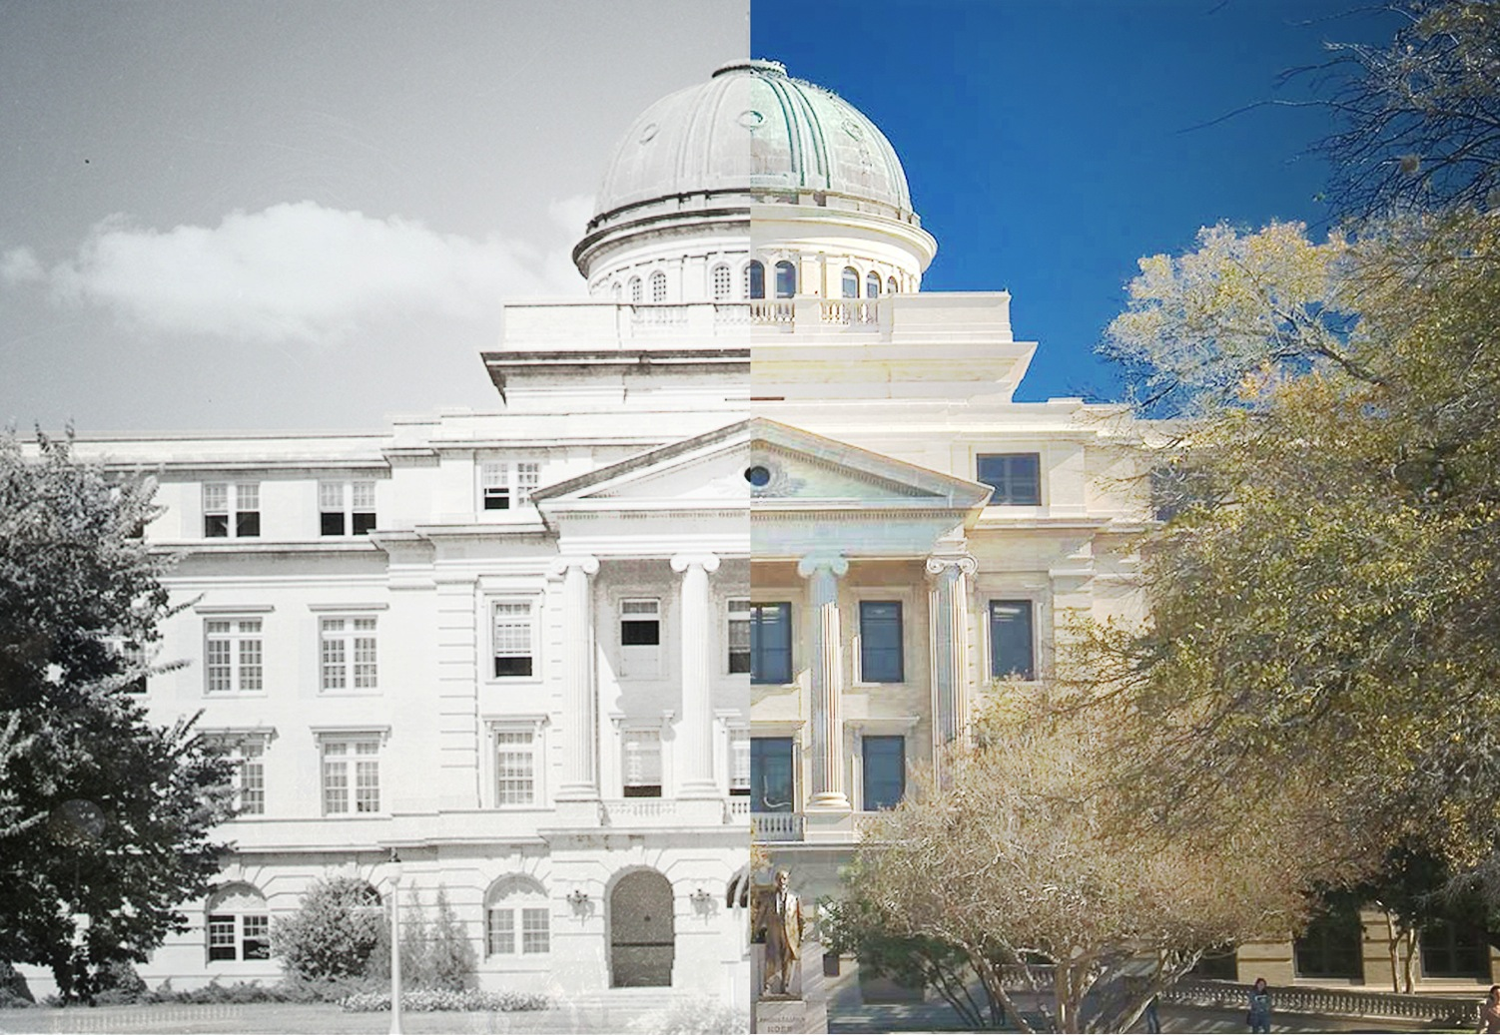
Clarity Over Time

Slide 6
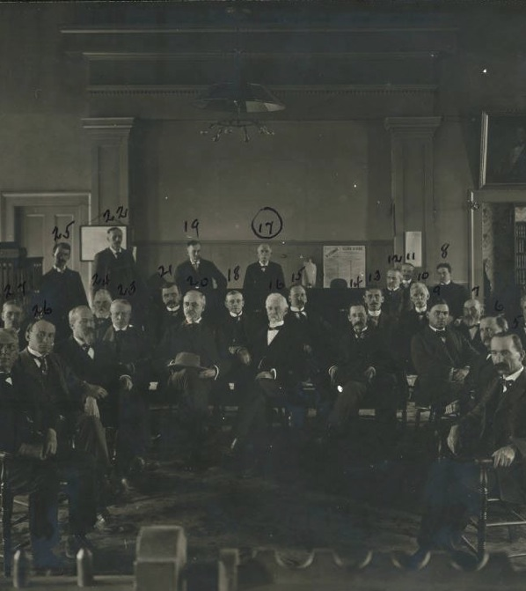
Professional Associations
1857
American Institute of Architects
1934
National Society of
Professional Engineers
1980
International Facility Management Association
1982
Construction Management Association of America
Notes:
IFMA is the world’s largest and most widely recognized international association for professional facility managers, supporting more than 19,000 members in 60 countries. The association’s members, represented in 125 chapters and 15 councils worldwide, manage more than 37 billion square feet of property and annually purchase more than $100 billion in products and services. Formed in 1980, IFMA certifies facility managers, conducts research, provides educational programs, recognizes facility management degree and certificate programs and produces World Workplace, the world’s largest facility management conference and exposition.

Slide 7
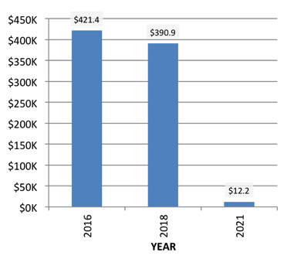
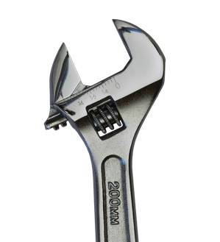

Comparison
Construction Management
  Project Delivery Perspective
Facility Management
  Operational Technical & Logistics Efficiency Perspective
Facility Asset Management
  Return on Investment Perspective
Notes:
IFMA is the world’s largest and most widely recognized international association for professional facility managers, supporting more than 19,000 members in 60 countries. The association’s members, represented in 125 chapters and 15 councils worldwide, manage more than 37 billion square feet of property and annually purchase more than $100 billion in products and services. Formed in 1980, IFMA certifies facility managers, conducts research, provides educational programs, recognizes facility management degree and certificate programs and produces World Workplace, the world’s largest facility management conference and exposition.

Slide 8
A Strategy for Making Better Decisions at Lower Risk and Costs – By Commander James J. Dempsey PE, USCG
… FAM fully embraces [facilities management] and further incorporates economics; financial, capital and resource management …
Provided for the Federal Facilities Council’s Forum October 31, 2006. Engineering, Construction, and Facilities Asset Management: A Cultural Revolution
FACILITY ASSET MANAGEMENT DOCTRINE
“Facility asset management (FAM) is a field of management that umbrellas all decisions related to facility investments to specifically include acquisition, construction, operations, maintenance, renewal and disposal ... Where traditional facilities management seeks to ensure the proper working order of a facility portfolio, FAM fully embraces this field and further incorporates economics; financial, capital and resource management; and the direct application of many decision and information management practices.”
Notes:
History
APPA was founded in Chicago in 1914 by representatives from fourteen Midwest institutions. Over the past 35 years, membership has grown - from 100 in 1970 to the current membership levels which exceeds 5,200 individuals in over 1,500 learning institutions throughout the United States, Canada, and abroad.
Two-year institutions were admitted to membership in 1969. The headquarters was established in Washington, D.C. in June 1972 and moved to Alexandria, Virginia in July 1984. APPA expanded its global outreach in 1993 with the creation of its first international region. In 2003, APPA embraced the philosophy of international outreach rather than membership, to allow international regions and other sovereign countries to organize and relate to APPA in new and different ways.
Organized originally as the Association of Superintendents of Buildings and Grounds, the association later became the Association of Physical Plant Administrators of Universities and Colleges. In 1991, the name APPA: The Association of Higher Education Facilities Officers was adopted to reflect increased higher education-based campus responsibilities. In 2005, the association began to identify itself simply as APPA, to pay homage to its long history, but to be inclusive of all types of educational institutions.
At the APPA 2007 conference in Baltimore on July 15, the association introduced the organization’s new logo and tagline, representative of APPA’s new brand personality. The new APPA brand logo and tagline are meant to capture what our organization is all about and are the foundations for the accomplishment of the first of APPA’s 7 Key Strategies – the development of a clear brand personality.

Slide 9
ACADEMIA
The Profession of Facility Asset Management
Dr. Sarel Lavy

Slide 10
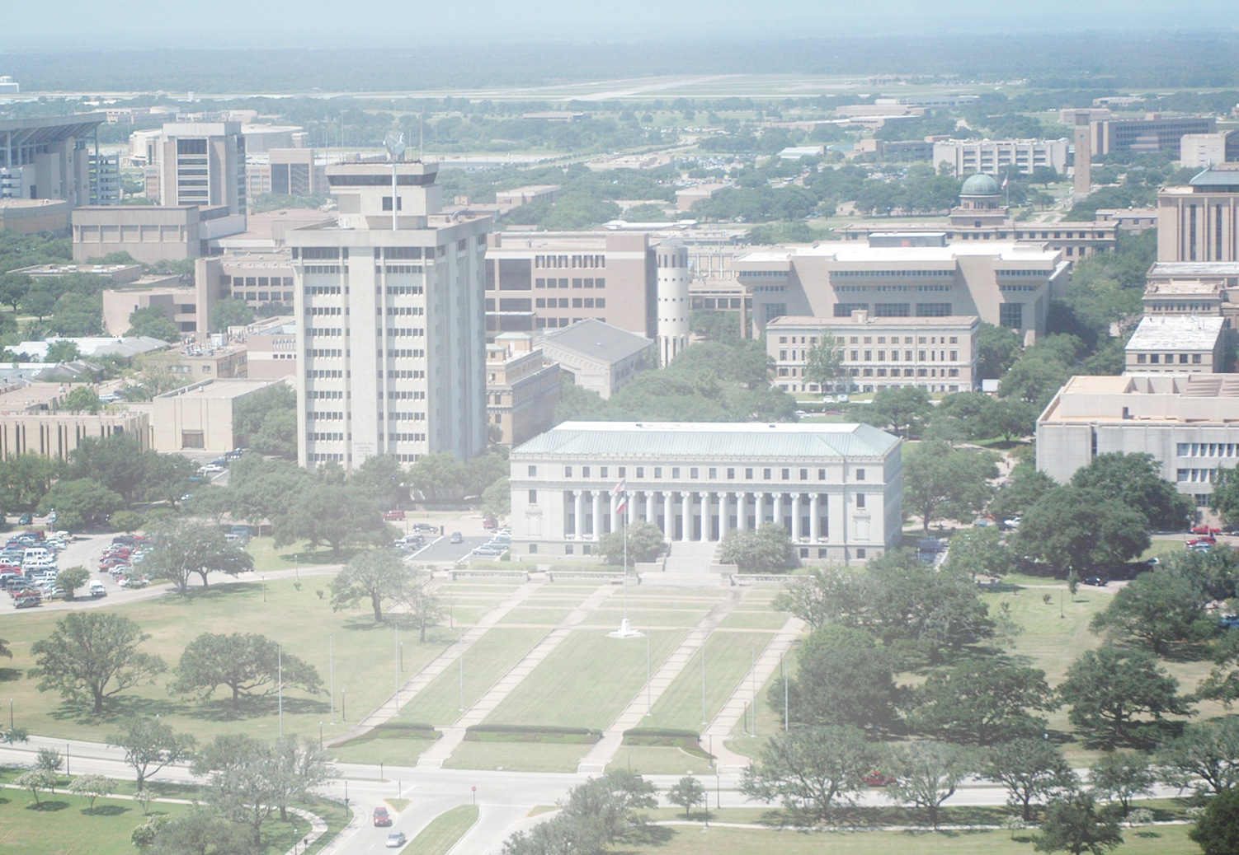
Growing Opportunity

Slide 11


Facility Management
Notes:
Opening slide …….. Have this up during introduction of Sarel

Slide 12
The CRS Center
The CRS Center began operations in 1990 with an endowment from the Texas based architecture firm
Caudill Rowlett Scott
The Center’s activities focus on the generation and dissemination of knowledge, education and service to professions concerned with the design, construction
and management of the built environment
At the core of the Center’s philosophy is the concept
that …
Notes:
Houston based Caudill Rowlett Scott was a pre-eminent Texas Architecture firm with San Antonio connections, having participated in the design of the Hemisfair park and also designed the Institute of Texan Cultures

Slide 13

The CRS Center
Bill Caudill, FAIA
Notes:
Bill Caudill FAIA, founding partner of CRS pioneered many concepts we take for granted today……..

Slide 14
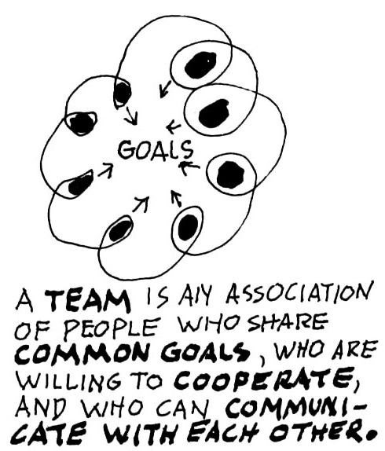
The CRS Center
And …
Bill Caudill, FAIA
Notes:
Including the “TEAM” approach which is central to the CRS Center and FM

Slide 15
Facility Management Program
The FM Program formally began in 1999 with a graduate certificate in Facility Management administered by the CRS Center. The certificate is available to any student enrolled in a graduate degree program at Texas A&M University
The program has awarded 69 certificates to date
An academic minor in Facility Management was approved by Texas A&M University for introduction and that program joined its elder sibling in
Fall 2013. The minor is administered by the department of Construction Science in conjunction with the CRS Center and current enrollment is at
24 students
The first students are expected to graduate with a minor in Spring 2015
The Facility Management program relies heavily on the expertise, guidance and generosity of a Facility Management Industry Council

Slide 16
Facility Management Programs
Undergraduate Minor
(administered by Dept. of Construction Science)
Requirements
Minimum 18 credit hours (6 hours of required courses, 12 hours of elective courses)
Minimum 6 credit hours at 300, 400 level
No more than 6 credit hours can be double counted between student’s major and the FM minor
At least 2 courses (6 credit hours) must be taken outside student’s major area
Student must make a “C” or better in all courses for the minor

Slide 17
Facility Management Programs
Graduate Certificate
(administered by the CRS Center)
Requirements
Minimum 15 credit hours of FM coursework
(3 hours of required courses, 12 hours of elective courses)
Minimum 6 credit hours of required coursework (3 credit hours of COSC 670, Facilities Management, and 3 credit hours of capstone course)
At least 6 credit hours (2 courses) must be from one of the four major areas; O&M, Finance & Real Estate, Human/Environmental Factors, Planning, Management & Technology
At least 1 course (3 credit hours) must be taken outside student’s
major area
Student must be enrolled, in good standing, in a graduate degree
program at TAMU

Slide 18
Facility Management Programs
Graduate Student Research
Projects demonstrate two signature areas of excellence
in FM @ A&M
Sustainability
and
Modeling, Simulating & Managing Building Information (BIM for FM)
EXAMPLES …

Slide 19
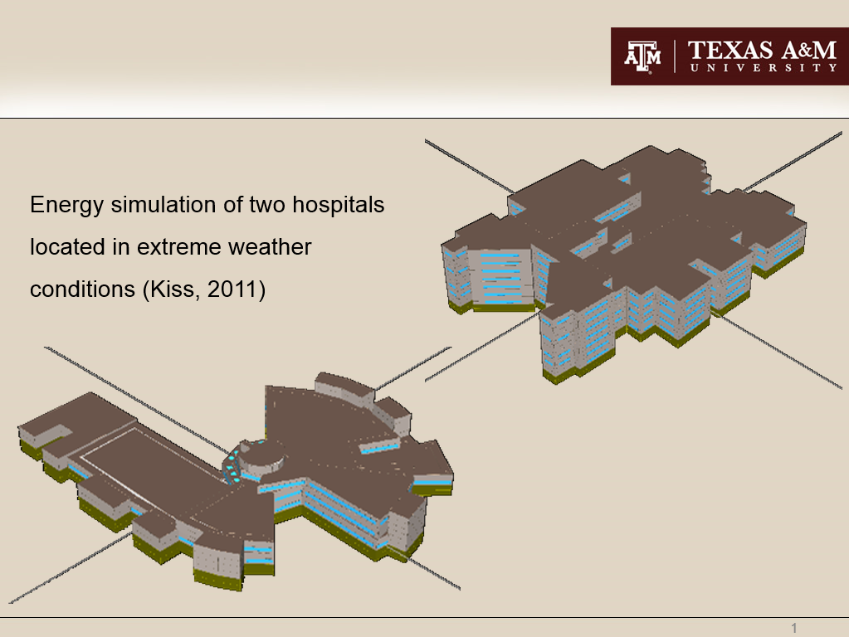
Sustainability

Slide 20
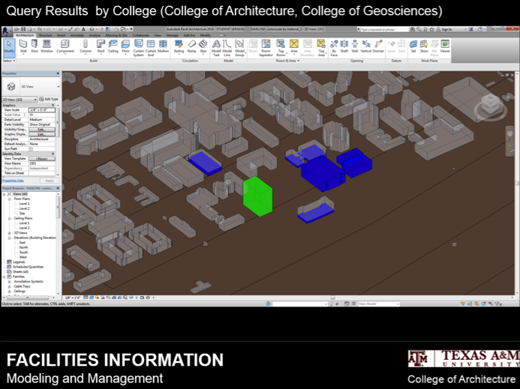
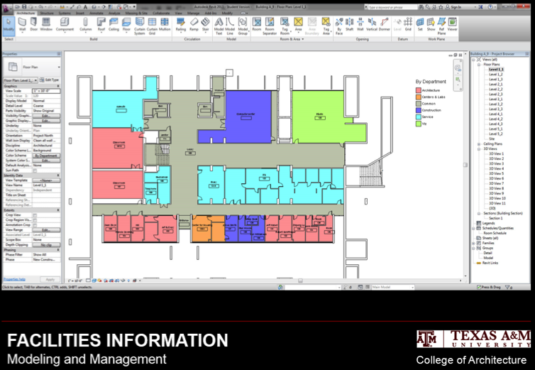
Campus BIM – FM
Notes:
An on-going project is the Campus BIM-FM project that has built, and is continuously enhancing, a BIM model of the College Station campus and exploring new ways of utilizing the model to manage various functions of the campus such as building and room occupancies & schedules, space utilization analyses, handicap accessibility issues and several sustainability projects related to energy, water, landscape, etc..

Slide 21
Opportunities
  Annual event, 16-17 October
  IFMA Student Chapter
  Scholarships
  Internships/Mentoring
  Guest Lectures
Notes:
Each year the FM program at TAMU holds an annual event to coincide with the FMIAC Exec. Cmte. meeting. This event features external speakers and this year will be held in conjunction with a special meeting of Facilities representatives of all major university campuses in the state and will focus on the relationship between academia and industry. We will inform you of more details shortly.

Slide 22
Contact Information
Sarel Lavy, PhD, M.ASCE
Associate Professor of Construction Science
Associate Director, CRS Center
Ph: 979.845.0632 Fax: 979.862.1572
email: slavy@arch.tamu.edu
Valerian Miranda, PhD, FIIA
Wallie E. Scott Jr. Professor of Architectural Practice & Management
Director, CRS Center
email: v-miranda@tamu.edu
CRS Center for Leadership & Management in the
Design & Construction Industries
College of Architecture, Texas A&M University
College Station, TX 77843-3137
Ph: 979.847.9357 Fax: 979.862.2235
email: crscenter@tamu.edu Web: crscenter.tamu.edu

Slide 23
OPPORTUNITIES:
SKILLS and KNOWLEDGE
The Profession of Facility Asset Management
Jeffrey J. Tafel

Slide 24
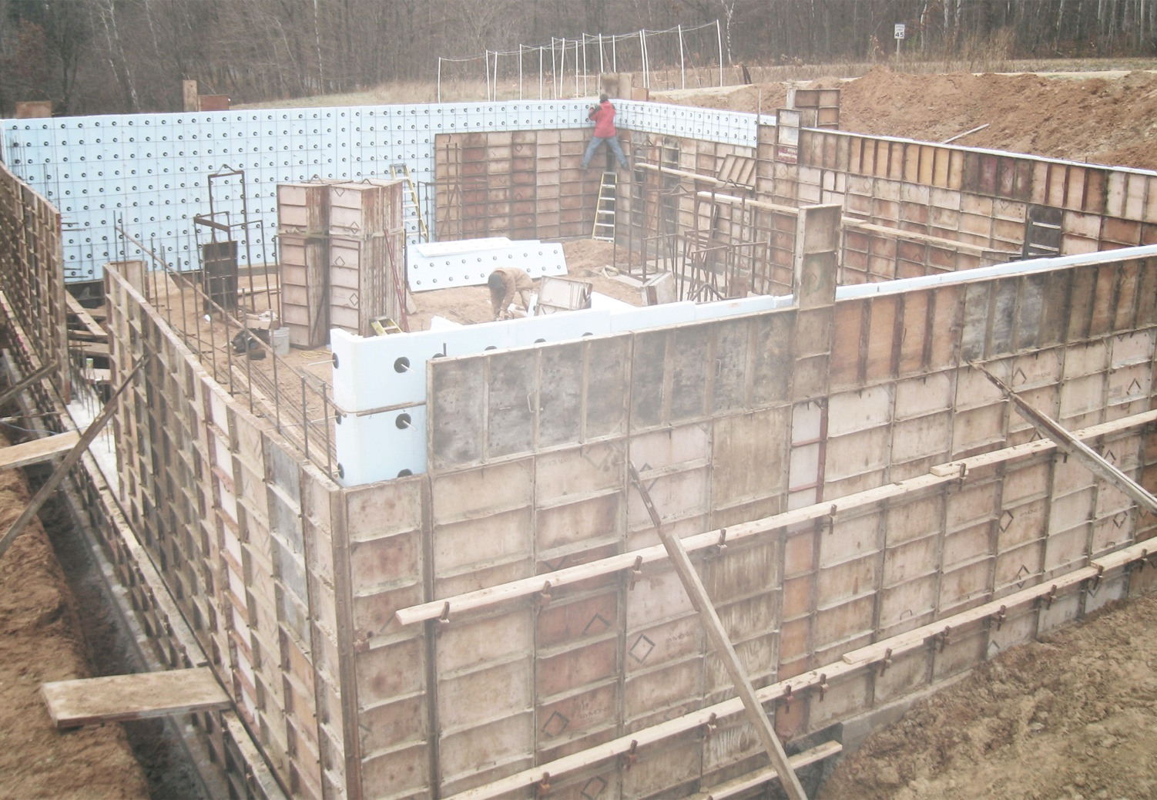
Foundations for Success

Slide 25
IFMA Foundation
The IFMA Foundation works for the
public good in support of Facility Management higher education, students studying
Facility Management and related fields,
research critical to the profession,
and increasing awareness of facility
management and making FM a
career of choice

Slide 26
The expanding FM Workforce Gap
Did you know…
For AT&T, there are approx. 1,000 FM (management) professionals
The approximate numbers of qualified retirements:
~ In 5 years = 350 personnel (35% of workforce)
~ In 10 years = 700 personnel (70% of workforce)
There are approximately 2,000 students enrolled in
IFMA Foundation accredited degree programs worldwide

Slide 27

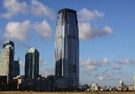


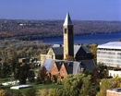


Global Workplace Workforce Initiative
Connecting:
  Business
  Economic Development
  Government
  Education
  Practitioners
  Students and Parents
Business
Academics
GWWI
Government
Economic Development

Slide 28
Global Workplace Workforce Initiative
Act as Connector and work with Sector Navigators connecting
business, local chapters, councils, higher education, K-12, STEM, government, economic development, students, parents
CONNECT
Offer IFMA “essentials” content to STEM, STEAM, ACE and other school programs. Train teachers and guidance counselors in FM. Provide “A Day in the Life of an FM” experience. Provide training to those entering FM from other occupations
EDUCATE
Excite students about FM with the Mars City Project. Engage students and parents with facility tours, presentations, chapter involvement,
and new student chapters
ENGAGE
INVEST
Invest in student scholarships, internships, externships,
mentorships, job fairs

Slide 29
Current Foundation Programs
Three major focus areas:
Accreditation of FM Degree Programs
  2-year, 4-year, and graduate FM degrees
FM Student Programs: Scholarships, FM Student ‘Pipeline’ initiative, E-Poster competition, International Student of the Year competition
Research on the profession (future focused)

Slide 30
Accredited Degree Programs (ADPs)
30 Facility Management Degree Programs
  11 Graduate Degrees
  16 Undergraduate (4-year) Degrees
  3 Undergraduate (2-year) Degrees
International Reach
  USA: 15
  Canada: 1
  Europe: 10
  Asia/Australia: 4
Notes:
IFMA Foundation Recognized Degree Program
The IFMA Foundation has developed standards to recognize quality facility management first-professional degree programs at colleges and universities. The recognized program initiative was designed to recognize and encourage the strengthening of current, valid facility management education degrees and to assist in the development of new facility management degree programs. The benefits of program recognition include:
* Automatic acceptance as a program provider whose courses and seminars are approved for certification maintenance points for Certified Facility Managers.
* Recognized program graduates are eligible to sit for the CFM exam one year sooner than graduates of non-recognized programs.
* Inclusion on a list describing recognized programs that is sent to individuals and employers who call IFMA or the IFMA Foundation about facility management degree programs.
* Recognition at IFMA's Annual Meeting, in IFMA publications and on Foundation web site.
Recognized Degree Program STANDARD (Revised 2008)
Recognized Degree Program APPLICATION
The following are institutions that offer first-professional degrees specifically in facility management. They qualified for recognition by submitting a detailed self-study application to the IFMA Foundation, which was reviewed and approved by a committee of peers. These institutions reapply for recognition every three years to ensure that the programs they offer continue to meet the standards set by the IFMA Foundation for quality facility management education. The primary purpose of this list is to let potential students, employers and others with an interest in facility management education know which programs have been set apart by taking the steps needed to become recognized.
North America
Bachelor Degree Programs
Brigham Young University, Provo, Utah offers a B.S. degree in Facilities Management with a Business Management Minor from the national recognized Marriott School of Management through the College of Engineering and Technology in the School of Technology Facilities Management. http://www.byu.edu/webapp/home/index.jsp Contact: Dr. Jeffrey Campbell, Chair, Facilities Management, 230 L Snell Building, Brigham Young University, Provo, UT 84602, +1.801. 422.8758. jcampbell@byu.edu
Conestoga College Institute of Technology and Advanced Learning, Kitchener, Ontario, Canada offers a Bachelors degree in Project and Facility Management. http://www.conestogac.on.ca. Contact: James Bechard at +1.519.748.5220 x2278, 299 Doon Valley Drive, Kitchener, Ontario, N2G 4M4, Canada. jbechard@conestogac.on.ca.
Cornell University, Ithaca, New York offers a B.S. and M.S. degree in Facilities Management. The programs are offered through the New York State College of Human Ecology. They also offer periodic CEU's in major cities such as New Orleans, New York and San Francisco. http://www.cornell.edu/ Contact: Ying Hua, Assistant Professor, +1.607.255.1950, Cornell University, Department of Design and Environmental Analysis, Ithaca, NY 14853. yh294@cornell.edu
Ferris State University, Big Rapids, Michigan offers a Bachelor of Science degree program in Facilities Management through the College of Technology. http://www.ferris.edu/homepage.htm Contact: Diane Nagelkirk, Associate Professor and Chair of Architectural Technology and Facility Management Department, nagelkid@ferris.edu, +231.591.2630. Please leave in the contact information the address.
Wentworth Institute of Technology, Boston, Massachusetts, offers a B.S. in Facilities Planning & Management through the Department of Design & Facilities. http://www.wit.edu/index.php Contact Suzanne Kennedy, CFM, CFMJ, Department Head, Associate Professor at +1.617. 989.4050.
550 Huntington Ave, Boston, MA 02115-5901. kennedys@wit.edu
Masters Degree Programs
Georgia Institute of Technology (Georgia Tech), Atlanta, Georgia, offers a Master of Science in Building Construction and Integrated Facility Management through the College of Architecture, Building Construction Program. Classes are offered in the evening to accommodate working professionals. http://www.gatech.edu/ Contact Kathy Roper, CFM, CFMJ, IFMA Fellow, MCR, LEED AP, Assistant Professor at +1.404. 385.4139 or +1.404.894.4875 for the graduate recruiter. Building Construction Management, 280 Ferst Dr, 1st Floor, Atlanta, GA 30332-0680. kathy.roper@coa.gatech.edu
Pratt Institute, Manhattan, New York, New York offers a Master of Science Degree in Facilities Management through the School of Architecture, Department of Facilities Management. Classes are offered in the evening to accommodate working professionals. http://www.pratt.edu/ Contact Professor Carol Reznikoff, at +1.212.647.7524, Pratt Manhattan, 144 West 14th Street, New York, New York 10011. crezniko@pratt.edu
Europe
Bachelor Degree Programs
FH Kufstein Tirol, Austria offers a Magister (FH) for Facility Management. http://www.fh-kufstein.ac.at/wi/jluethi/research_e.html Contact: Ing. Mag. (FH) Thomas Madritsch, FHS Kufstein BildungsGmbH, Andreas Hofer Straße 7 A-6330 Kufstein, Austria, tel. +43.53.727.1819. Thomas.madritsch@fh-kufstein.ac.at
Hanze University Groningen, The Netherlands offers a Bachelor degree program in Facilities Management through the School of Facility Management, in an international environment. http://www.hanze.nl/home/International Contact Jaap Wijnja, Zernikeplein 7, 9747 AS Groningen, The Netherlands. tel. +31.50.595.2605. j.g.wijnja@pl.hanze.nl
NHTV Breda University of Applied Science, offers a degree in Facility Management. http://www.nhtv.nl/default.aspx?themaset=c910a88f-0245-4d9e-b847-4dd2ebc0e2a7
Contact Rene J.F.M. Hermans, Sibeliuslaan 13, Breda NL - 4837 CA, The Netherlands, tel. +31.76.530.2780. hermans.r@nhtv.nl
Saxion Universities of Applied Sciences, Deventer, The Netherlands offers a Bachelors degree in Facility Management. http://www.saxion.nl. Contact: Dr. Brenda Groen, at +31.57.060.3153, Handelskade 75, Deventer, Postbus 51, 7400 AM Deventer, The Netherlands. b.h.groen@saxion.nl.
Masters Degree Programs
Leeds Metropolitan University Leeds, UK offers a web-based distance learning MSC in Facilities Management through the School of the Built Environment. This can be studied off-campus, world-wide. http://www.lmu.ac.uk/ Contact Roy Whitaker tel. +46.113.283.2600. r.s.whitaker@leedsmet.ac.uk
Asia
Bachelor Degree Program
The Hong Kong Polytechnic University, Hung Hom, Kowloon, Hong Kong offers a Graduate Program in Facility Management. http://www.polyu.edu.hk/cpa/polyu/main/main_e.php Contact Dr Danny Shiem-Shin Then, Department of Building Services Engineering, Stanley Ho Building, Level 7, Room FJ716, Hung Hom, Kowloon, Hong Kong+852. 2766.4558, bessthen@polyu.edu.hk

Slide 31
FM ADP Growth
Notes:
The Foundation promotes higher FM education through its Accredited Degree Program.
For the profession to reach the top-of-mind awareness necessary for FM to become a career of choice, it is essential to increase the number of college graduates with FM degrees. A strong accreditation program for degrees in Facility Management is key for the profession’s future.
FM Accredited Degree Programs account for more than 800 FM students – an increase of more than 150% since 2008. The standards for these degree programs are continually updated to meet the demands of the rapidly changing and evolving FM profession and to ensure that these new colleagues are well-equipped to meet the demands of FM now and in the future.
The ADP is the single largest investment in human and financial resources of the IFMA Foundation. Financial investment in the ADP exceeds $200,000 annually, and is where the vast majority of unrestricted donations and contributions are allocated.
More than 50 volunteers from academia and practitioners are actively engaged in a number of ADP related initiatives including:
-Update of the FM Accredited Degree Standard and the FM Accreditation Commission
-Application for FM ADP recognition by CHEA, the Council for Higher Education Accreditation
-Continued growth of the FM ADP program that will result in the profession more frequently being entered as a degreed career of choice

Slide 32
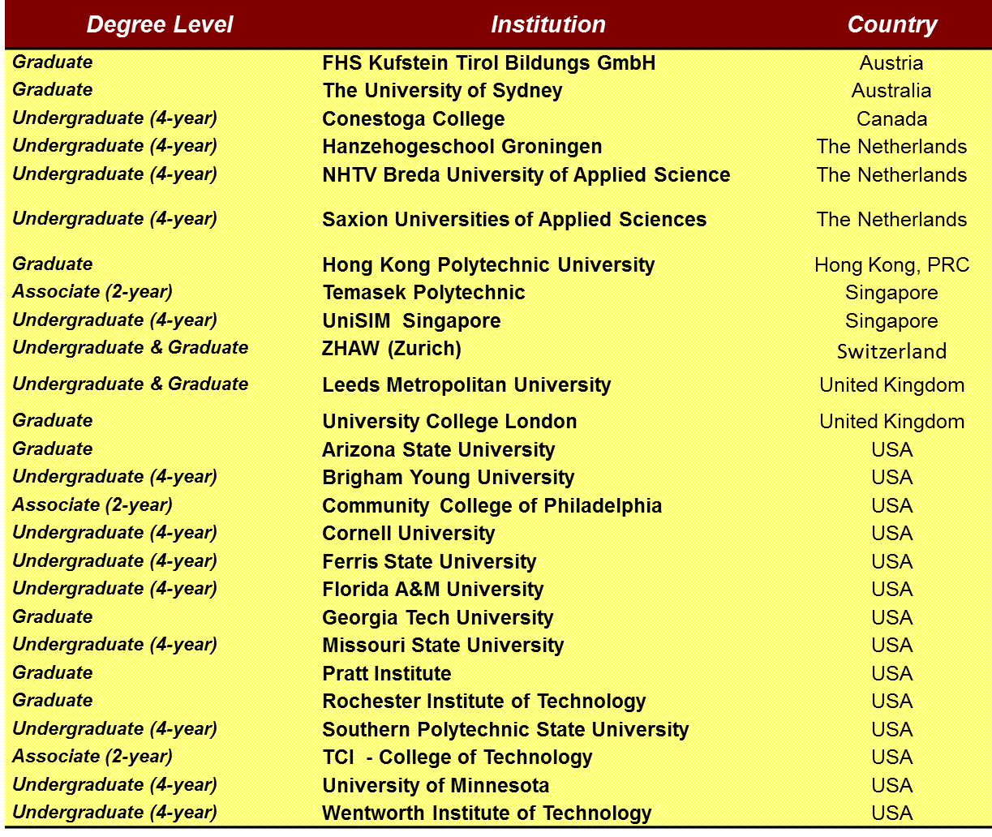

Slide 33
Accredited Degree Program
FM ADP: What is it?
  An Accredited FM Degree Program ensures our profession’s
  vital core competencies are embedded into the institution’s
  academic coursework
  Accreditation is a voluntary method / process of quality assurance
  used by universities and institutions designed primarily to
  distinguish schools adhering to a set of educational standards
  The Foundation’s FM Accredited Degree Program (ADP)
  ensures current students, potential employers, parents and
  prospective students that the accredited FM degrees meet the
  rigorous academic standard for quality, subject content and
  student outcome requirements
Notes:
IFMA Foundation Recognized Degree Program
The IFMA Foundation has developed standards to recognize quality facility management first-professional degree programs at colleges and universities. The recognized program initiative was designed to recognize and encourage the strengthening of current, valid facility management education degrees and to assist in the development of new facility management degree programs. The benefits of program recognition include:
* Automatic acceptance as a program provider whose courses and seminars are approved for certification maintenance points for Certified Facility Managers.
* Recognized program graduates are eligible to sit for the CFM exam one year sooner than graduates of non-recognized programs.
* Inclusion on a list describing recognized programs that is sent to individuals and employers who call IFMA or the IFMA Foundation about facility management degree programs.
* Recognition at IFMA's Annual Meeting, in IFMA publications and on Foundation web site.
Recognized Degree Program STANDARD (Revised 2008)
Recognized Degree Program APPLICATION
The following are institutions that offer first-professional degrees specifically in facility management. They qualified for recognition by submitting a detailed self-study application to the IFMA Foundation, which was reviewed and approved by a committee of peers. These institutions reapply for recognition every three years to ensure that the programs they offer continue to meet the standards set by the IFMA Foundation for quality facility management education. The primary purpose of this list is to let potential students, employers and others with an interest in facility management education know which programs have been set apart by taking the steps needed to become recognized.
North America
Bachelor Degree Programs
Brigham Young University, Provo, Utah offers a B.S. degree in Facilities Management with a Business Management Minor from the national recognized Marriott School of Management through the College of Engineering and Technology in the School of Technology Facilities Management. http://www.byu.edu/webapp/home/index.jsp Contact: Dr. Jeffrey Campbell, Chair, Facilities Management, 230 L Snell Building, Brigham Young University, Provo, UT 84602, +1.801. 422.8758. jcampbell@byu.edu
Conestoga College Institute of Technology and Advanced Learning, Kitchener, Ontario, Canada offers a Bachelors degree in Project and Facility Management. http://www.conestogac.on.ca. Contact: James Bechard at +1.519.748.5220 x2278, 299 Doon Valley Drive, Kitchener, Ontario, N2G 4M4, Canada. jbechard@conestogac.on.ca.
Cornell University, Ithaca, New York offers a B.S. and M.S. degree in Facilities Management. The programs are offered through the New York State College of Human Ecology. They also offer periodic CEU's in major cities such as New Orleans, New York and San Francisco. http://www.cornell.edu/ Contact: Ying Hua, Assistant Professor, +1.607.255.1950, Cornell University, Department of Design and Environmental Analysis, Ithaca, NY 14853. yh294@cornell.edu
Ferris State University, Big Rapids, Michigan offers a Bachelor of Science degree program in Facilities Management through the College of Technology. http://www.ferris.edu/homepage.htm Contact: Diane Nagelkirk, Associate Professor and Chair of Architectural Technology and Facility Management Department, nagelkid@ferris.edu, +231.591.2630. Please leave in the contact information the address.
Wentworth Institute of Technology, Boston, Massachusetts, offers a B.S. in Facilities Planning & Management through the Department of Design & Facilities. http://www.wit.edu/index.php Contact Suzanne Kennedy, CFM, CFMJ, Department Head, Associate Professor at +1.617. 989.4050.
550 Huntington Ave, Boston, MA 02115-5901. kennedys@wit.edu
Masters Degree Programs
Georgia Institute of Technology (Georgia Tech), Atlanta, Georgia, offers a Master of Science in Building Construction and Integrated Facility Management through the College of Architecture, Building Construction Program. Classes are offered in the evening to accommodate working professionals. http://www.gatech.edu/ Contact Kathy Roper, CFM, CFMJ, IFMA Fellow, MCR, LEED AP, Assistant Professor at +1.404. 385.4139 or +1.404.894.4875 for the graduate recruiter. Building Construction Management, 280 Ferst Dr, 1st Floor, Atlanta, GA 30332-0680. kathy.roper@coa.gatech.edu
Pratt Institute, Manhattan, New York, New York offers a Master of Science Degree in Facilities Management through the School of Architecture, Department of Facilities Management. Classes are offered in the evening to accommodate working professionals. http://www.pratt.edu/ Contact Professor Carol Reznikoff, at +1.212.647.7524, Pratt Manhattan, 144 West 14th Street, New York, New York 10011. crezniko@pratt.edu
Europe
Bachelor Degree Programs
FH Kufstein Tirol, Austria offers a Magister (FH) for Facility Management. http://www.fh-kufstein.ac.at/wi/jluethi/research_e.html Contact: Ing. Mag. (FH) Thomas Madritsch, FHS Kufstein BildungsGmbH, Andreas Hofer Straße 7 A-6330 Kufstein, Austria, tel. +43.53.727.1819. Thomas.madritsch@fh-kufstein.ac.at
Hanze University Groningen, The Netherlands offers a Bachelor degree program in Facilities Management through the School of Facility Management, in an international environment. http://www.hanze.nl/home/International Contact Jaap Wijnja, Zernikeplein 7, 9747 AS Groningen, The Netherlands. tel. +31.50.595.2605. j.g.wijnja@pl.hanze.nl
NHTV Breda University of Applied Science, offers a degree in Facility Management. http://www.nhtv.nl/default.aspx?themaset=c910a88f-0245-4d9e-b847-4dd2ebc0e2a7
Contact Rene J.F.M. Hermans, Sibeliuslaan 13, Breda NL - 4837 CA, The Netherlands, tel. +31.76.530.2780. hermans.r@nhtv.nl
Saxion Universities of Applied Sciences, Deventer, The Netherlands offers a Bachelors degree in Facility Management. http://www.saxion.nl. Contact: Dr. Brenda Groen, at +31.57.060.3153, Handelskade 75, Deventer, Postbus 51, 7400 AM Deventer, The Netherlands. b.h.groen@saxion.nl.
Masters Degree Programs
Leeds Metropolitan University Leeds, UK offers a web-based distance learning MSC in Facilities Management through the School of the Built Environment. This can be studied off-campus, world-wide. http://www.lmu.ac.uk/ Contact Roy Whitaker tel. +46.113.283.2600. r.s.whitaker@leedsmet.ac.uk
Asia
Bachelor Degree Program
The Hong Kong Polytechnic University, Hung Hom, Kowloon, Hong Kong offers a Graduate Program in Facility Management. http://www.polyu.edu.hk/cpa/polyu/main/main_e.php Contact Dr Danny Shiem-Shin Then, Department of Building Services Engineering, Stanley Ho Building, Level 7, Room FJ716, Hung Hom, Kowloon, Hong Kong+852. 2766.4558, bessthen@polyu.edu.hk

Slide 34
ADP Standard
  Updated ADP Standard released early 2014
  Based on IFMA’s most recent Global Job Task Analysis (GJTA) which defined the 11 core competencies of the FM profession
  Facility managers from 62 countries were involved in the GJTA, the most comprehensive to date and the first truly global survey and analysis

Slide 35
FM Core Competencies
Communication:
communication plan and processes for both internal and external stakeholders
Emergency Preparedness and Business Continuity:
emergency and risk management plans, procedures
Environmental Stewardship and Sustainability:
sustainable management of built & natural environments
Finance and Business:
strategic plans, budgets, financial analyses, procurement
Human Factors:
healthful & safe environment, security, employee development

Slide 36
FM Core Competencies
Leadership and Strategy:
strategic planning; organize, staff and lead facility organization
Operations and Maintenance:
building operations and maintenance, occupant services
Project Management:
oversight and management of all projects and related contracts
Quality:
best practices, process improvements, audits and measurements
Real Estate and Property Management:
real estate planning, acquisition, disposition.
Technology:
facility management technology, workplace management systems.

Slide 37
Updated ADP Standard
Describes both scholarly and real-world facility management
applications and practices
Provides a comprehensive model for an ideal facility
management program
The Facility Management Accreditation Commission
establishes student-based outcomes for accreditation
Achieving those outcomes is not defined by any empirical measure,
but rather by demonstrating competencies through assessment
defined within those outcomes
Each program is encouraged to retain its uniqueness while
providing the basic curricular structure needed to assure that
its graduates are truly prepared for real-world careers
in facility management

Slide 38
Updated ADP Standard
  Recognizes the importance of variation and diversity in program offerings
  Institutional acknowledgement that facility management is a profession that has come of age and has clearly definable professional competencies that translate into academic program outcomes

Slide 39
Academic FM Research
Academic and Research Track at WW
  The Academic & Research track is a “double blind” peer review initiative to allow Academics and Researchers the opportunity to present and discuss Facility Management, the Built Environment and related topics
  Goal: Gain expanded understanding of the research priorities and methods employed
  All abstracts and full papers are double blind peer reviewed by
  a panel of highly qualified Academics / Researchers with
  expertise in topic areas
  30 such papers and presentations are expected for World Workplace 2014 in New Orleans
Notes:
This new Foundation Initiative underscores the Foundation’s commitment to FM Higher Education and the academics teaching and researching within the profession worldwide.

Slide 40
FAM - The JOB
The Profession of Facility Asset Management
John A. Garcia

Slide 41
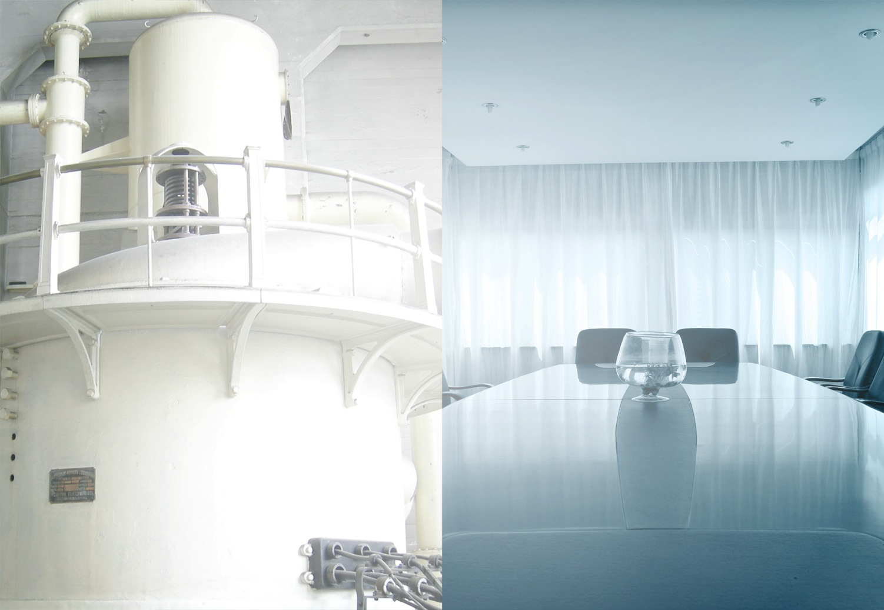
Boiler Room to Boardroom

Slide 42

FAM Leadership Responsibilities
GOALS
  Build or Enhance a Facility Asset Management System
  Efficiently Protect and Enhance Functionality
  and Quality
  Foster Accountability
  For Stewardship
  Strategically Prioritize and Allocate Resources for Maintenance, Repair, Renovation and New Construction
OBJECTIVES
  Outline a process and
  services to accomplish
  the goals
  Provide a proposal for
  the outlined process
  Provide an overview presentation of the
  information for an executive leadership decision presentation
  on – date –

Slide 43
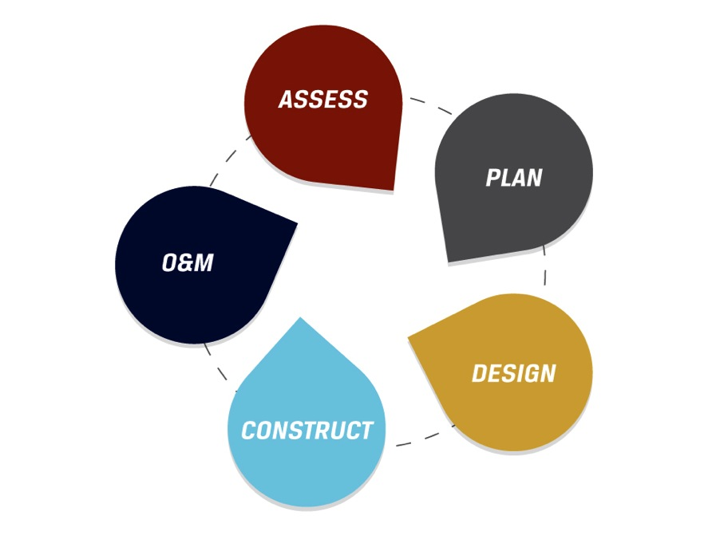
Facility Management Processes

Slide 44
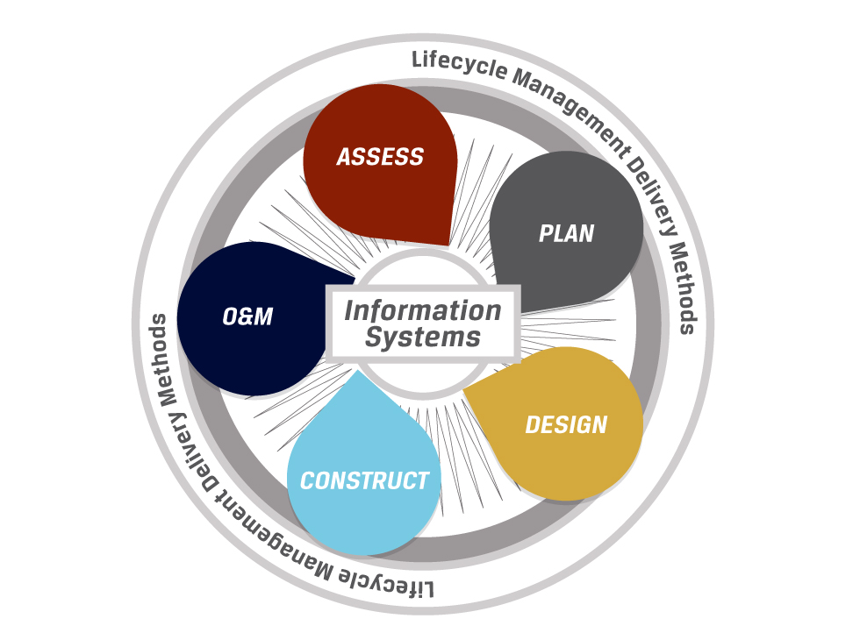
Facility Asset Management

Slide 45
Knowledge Development Process
Understand Where You Are Today
Understand Where Improvement Can Be Made
Improve Information Knowledge Base
Improve Decision Making
Desired Outcome

Slide 46
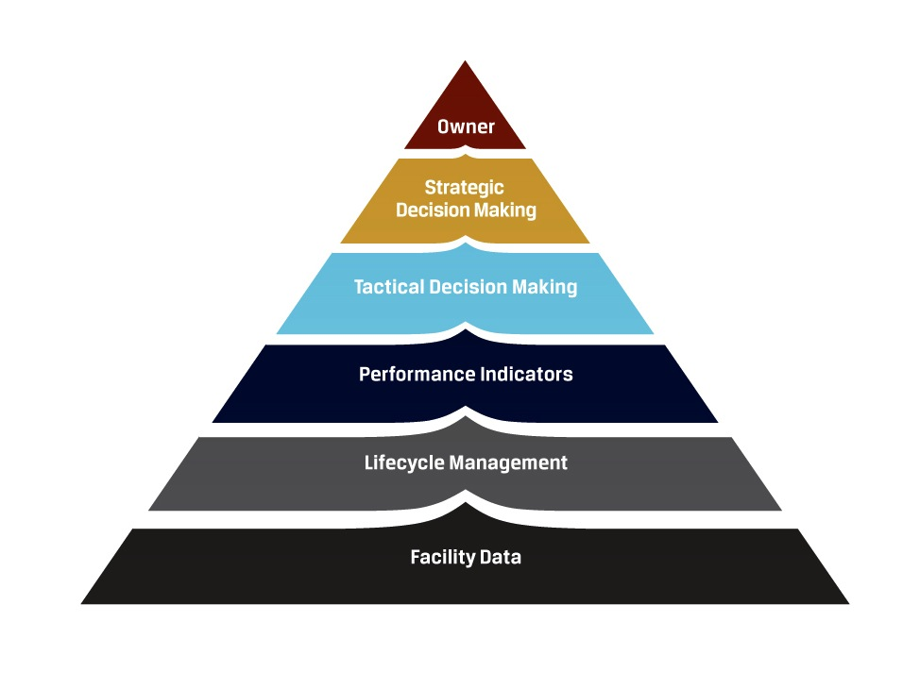
Facility Information Management

Slide 47
Strategies
Foster Accountability
For Stewardship
  Adopt standardized budgeting and cost accounting
  Establish facilities
  steering group
  Establish facilities performance measures
  Empower facilities program managers by providing incentives and removing organizational barriers
Strategically Allocate Resources for Facility Asset Management
  Incorporate a facilities component in strategic plan
  Establish and refocus condition assessment program
  Make Priorities and business rules for project definition
  Create design guide and performance specifications

Slide 48
The CAREER
The Profession of Facility Asset Management
John A. Garcia

Slide 49

FAM Career Path

Slide 50
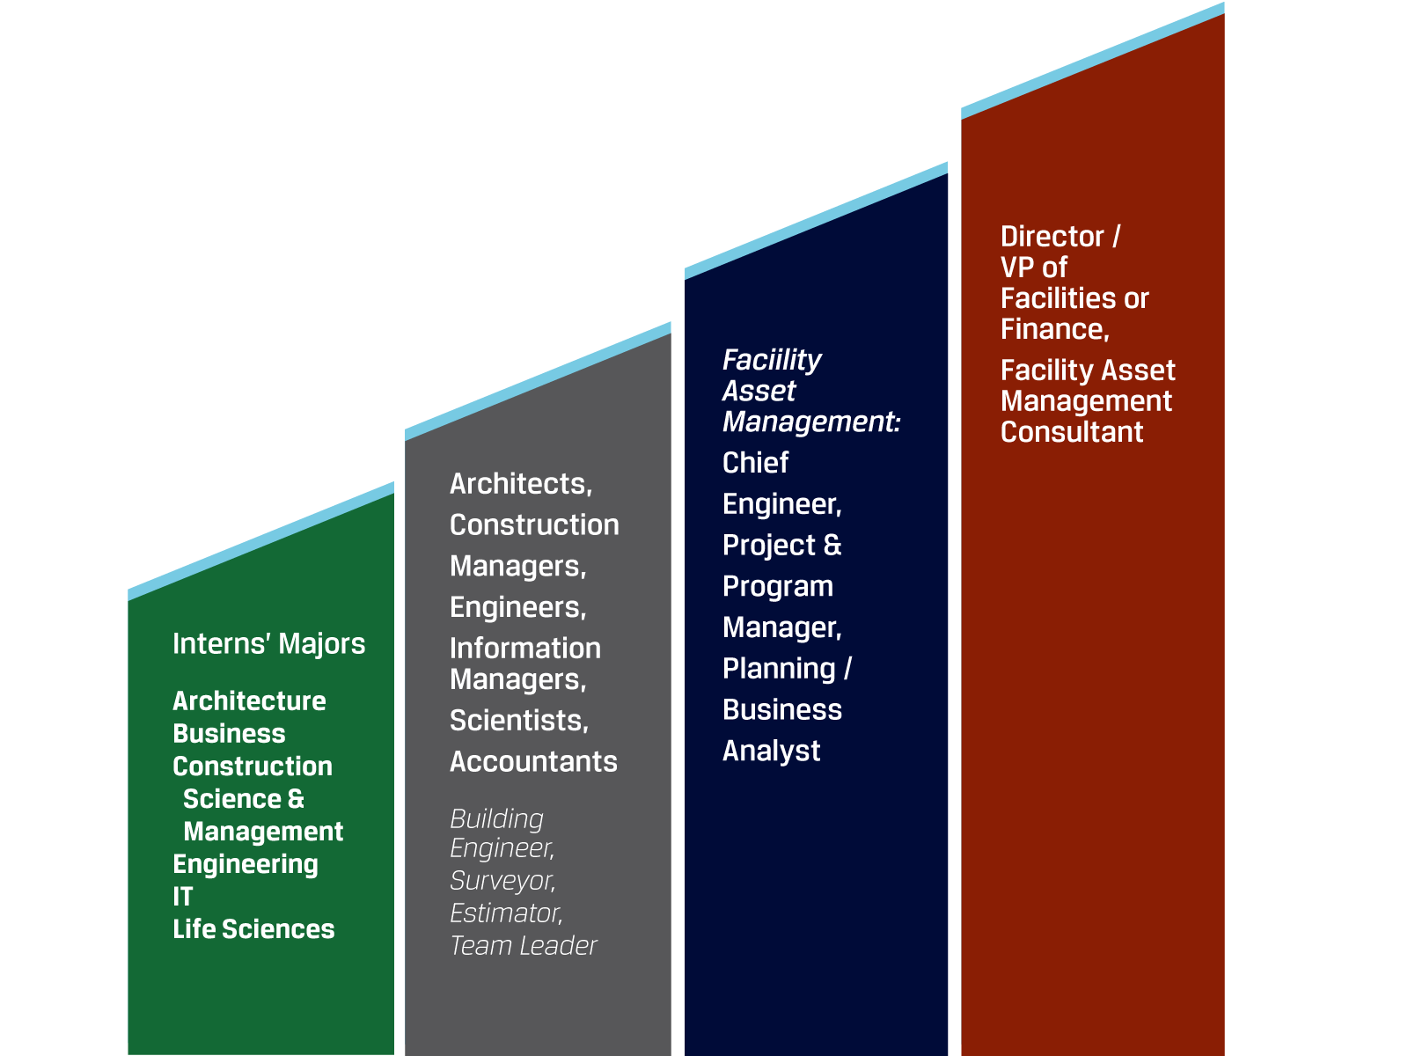
Responsibility

Slide 51



THANK YOU

